Slide 1
Onedot
Data Integration

Slide 2
Key Facts of Input And Output Data Sets
Input
Output
9 Columns
18 Columns
21908 Rows
1153 Rows
1153 unique car IDs
1153 unique car IDs
24 Features for each unique Car IDs
18 Features for each car
Not: Total of 24 columns extracted from Input Data per car but 18 of them used
Not: 6 Features were discarded as there was no columns corresponded in Output Data

Slide 3
Process Flow
Getting Data
Normalizing
Data was obtained as Json Type
Discarding, generating new columns and changing name of the columns for smooth integration to Target Dataset
Extracting some features from rows into columns and partitioning the rows per Car
Making some alterations on the data types to match Target Data Values (i.e. Language / De-Eng)
Pre-processing
Integrating

Slide 4
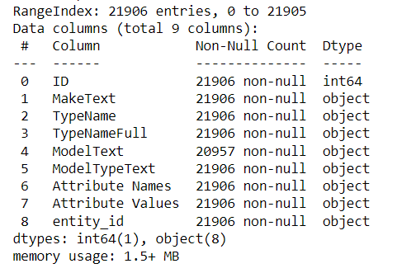
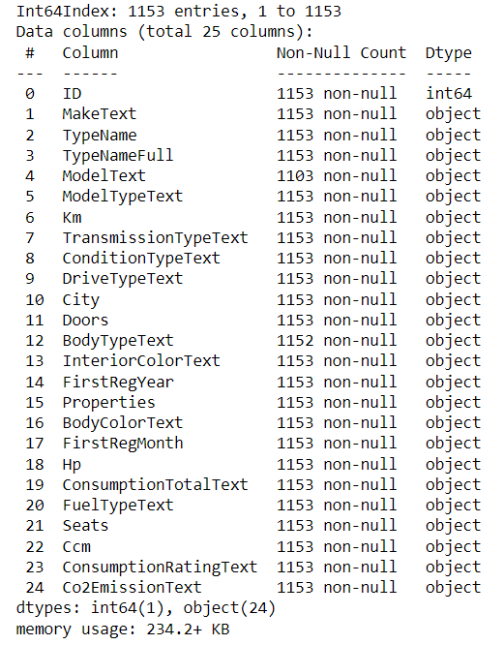
What is the Pre-Process about ?
During the pre-processing, the data was reshaped by extracting some attributes from rows into columns as well as grouping the unique car ids

Slide 5
What Was Changed During Normalization?
These are some of the changes however there are few more attributes that could have been also changed such as Transmission Type, Drive Type, Interior Color values (Language) or Additional properties (Race Car, MFK).
These features were not imposed to normalization process because there were already going to be discarded in the Target Data
Car type could have been partitioned more specifically. (like Car,Van,Truck, Motorbike etc)
Condition
German-English
Fuel Consumption Unit Grouping Values - Assigning
Body Colour
German-English
Car Type
German-English
Grouping Values - Assigning

Slide 6
Integration
In the integration part some of the columns were discarded as there were no place in the Target Scheme.
Car ID
CO2 emission
Interior color
Engine displacement
Hp
Number of doors
Transmission type
Drive type
Properties
Average fuel consumption
Fuel type
Number of seats
Consumption rating
Some of these attributes could have been helpful for the end users like Hp or Transmission Type as they have predominantly relevant information with the cars. Another point is, regarding these features, by using few features together such as Consumption rating, CO2 emission, Average Fuel Consumption and Fuel Type, A new column could also be generated in terms of Emission Controls (i.e London Ulez Regulations) or Eco-Friendly styles etc.

